Slide 1






Partnerships
towards sustainable development
Dr. Mette Morsing
Head of PRME
Principles for Responsible Management
UN Global Compact, New York
The Annual Sustainability Conference 2nd edition
Luxor, 2-5 March 2022

Slide 2
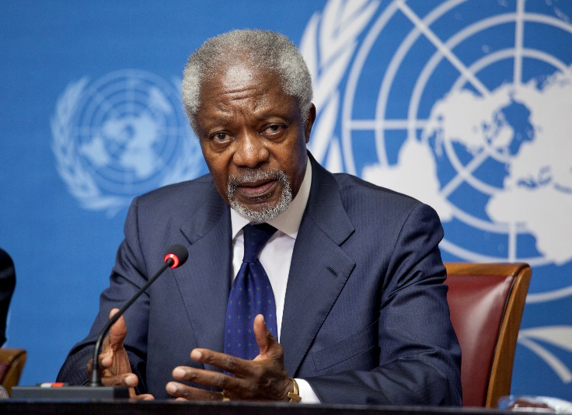
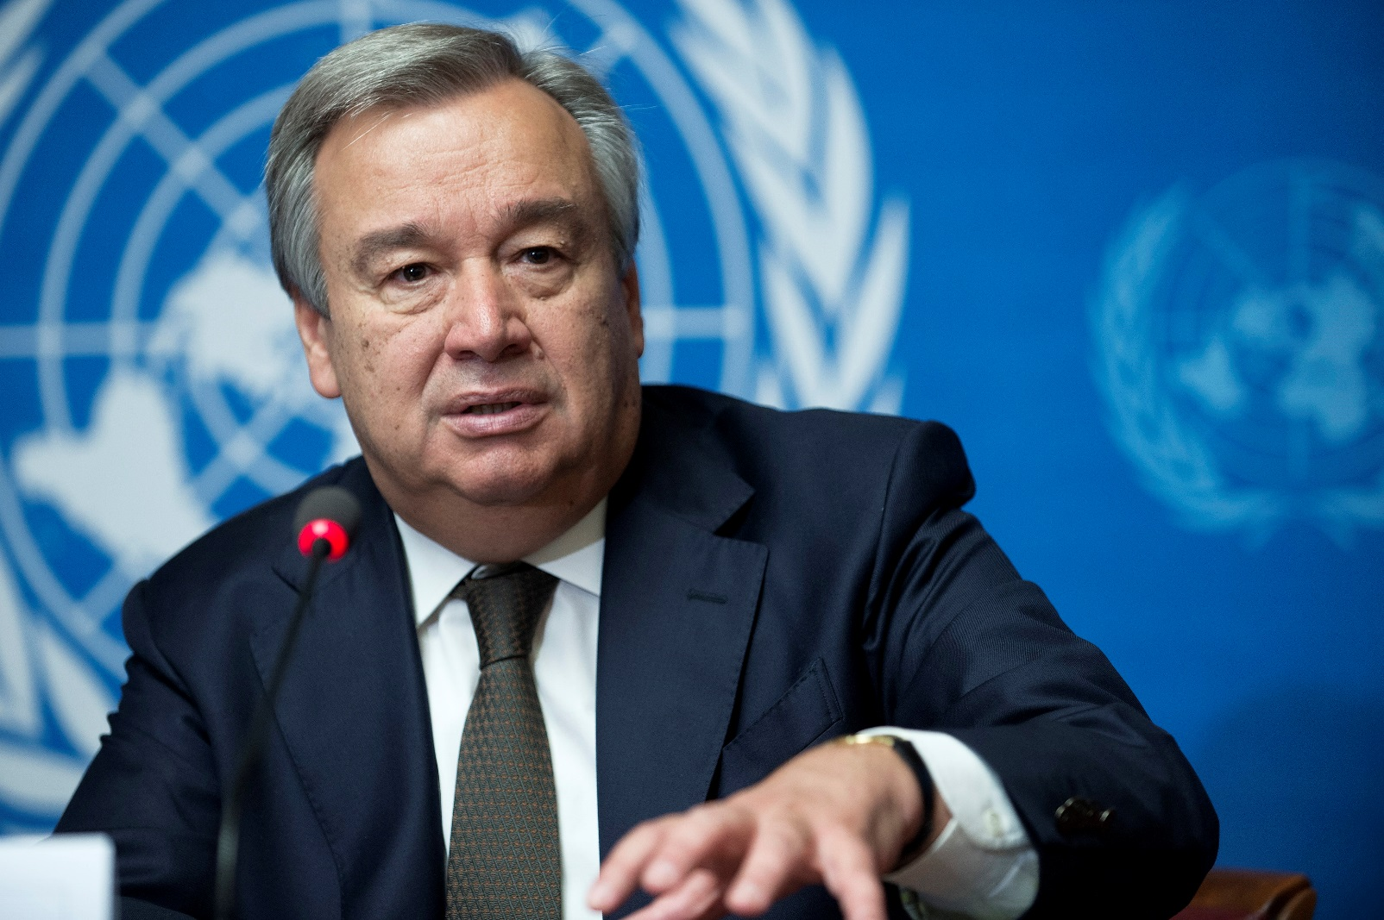
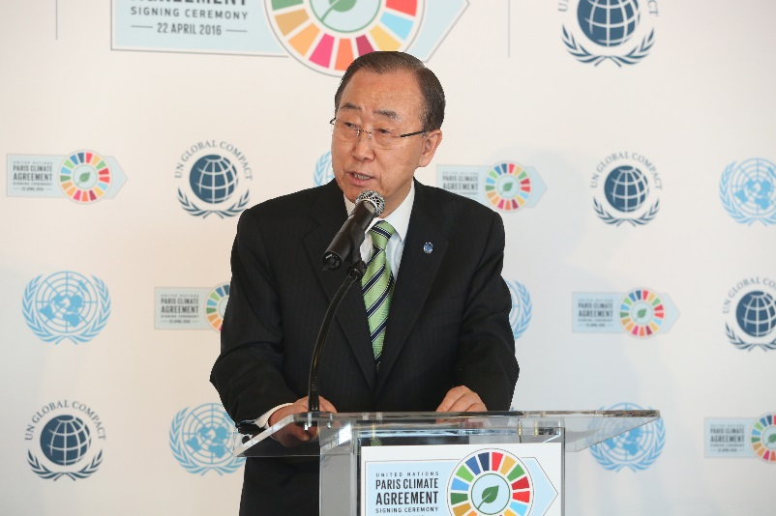
UNITED NATIONS GLOBAL COMPACT
“I propose that you, the business leaders… and we, the United Nations, initiate a global compact of shared values and principles, which will give a human face to the global market.”
“Since there can be no poverty eradication without generation of wealth, we should further promote the UN Global Compact, highlighting the benefits of corporate responsibility.”
Kofi Annan, UN Secretary-General (1997-2006) World Economic Forum, 2009
“I have seen first-hand the power of the UN Global Compact’s Ten Principles on human rights, labour, environment and anti-corruption. They are helping thousands of companies contribute to sustainability.”
António Guterres, UN Secretary-General
Secretary-General Election Vision Statement, 2016
Ban Ki-Moon, UN Secretary-General (2007-2016) UNGC Leaders Summit, 2009

Slide 3

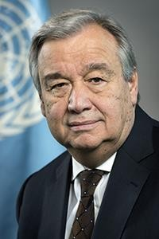
A call for the Decade of Action A call for corporate leadership
UN Declaration of Human Rights (1948):
https://www.un.org/en/about-us/universal-declaration-of-human-rights
UN SDGs (2015):
https://sdgs.un.org/goals
UN SG (2019):
“We are seriously off-track!”
“It is both good ethics and good business to invest in sustainable, equitable development,” he wrote.
“Corporate leadership can make all the difference to creating a future of peace, stability and prosperity on a healthy planet.”
Recent protesters across the world have taken to the streets to protest rising living costs as well as real, or perceived, injustice: “They feel the economy is not working for them — and in some cases, they are right. A narrow focus on growth, regardless of its true cost and consequences, is leading to climate catastrophe, a loss of trust in institutions and a lack of faith in the future,” (Guterres, Financial Times, 2019)
H.E. António Guterres
Secretary General
United Nations

Slide 4
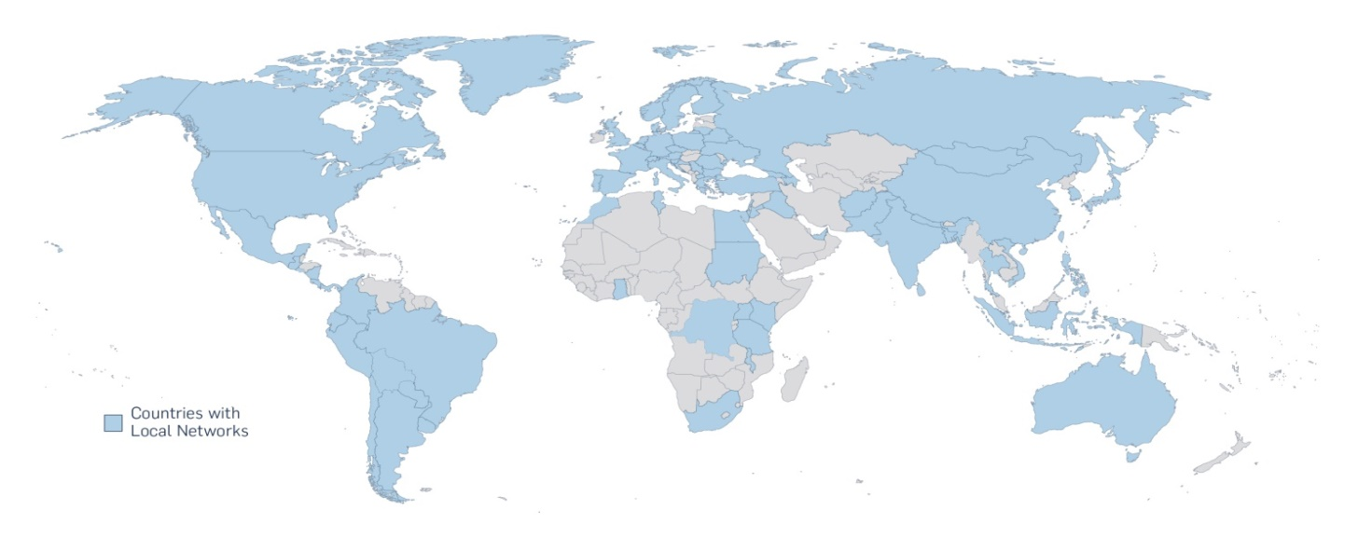

UN GLOBAL COMPACT TODAY: "CEO SURVEY 2021”
>14,000
businesses committed to the Ten Principles of the UN Global Compact
Human Rights
Labour
Environment
Anti-Corruption
Fill up
>3,000 non-business members
>70 Local Networks
28% Fortune 500
66 million working in a company active in the UN Global Compact

Slide 5

“CEO SURVEY”: CEOS UNDERSTAND THE RESPONSIBILITY & OPPORTUNITY
86%
CEOs agree the system needs to refocus on equitable growth
81%
Taking action on the SDGs
77%
See the opportunity to build brand trust
71%
Agree business can make a significant impact on the SDGs
…but
21%
Think business is actually making an impact

Slide 6
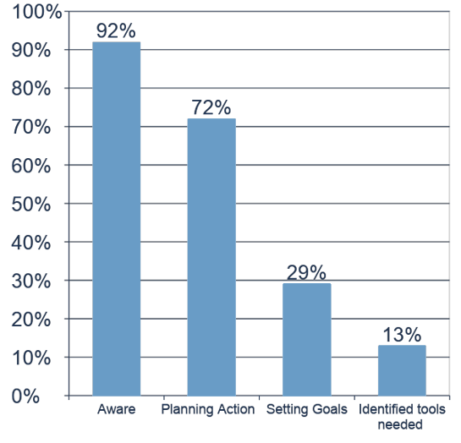
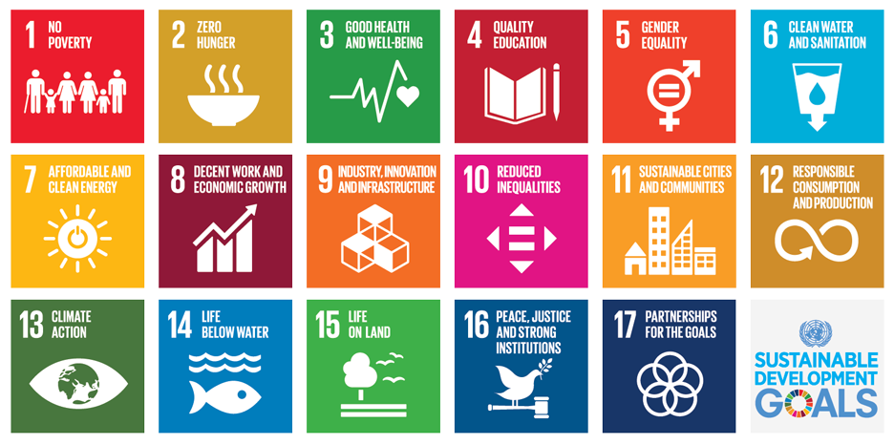
BUSINESSES ARE ENGAGED, but need tools and training
Source: Make it your business: Engaging with the Sustainable Development Goals, PwC (2015)

Slide 7
Six transformational processes to achieve the United Nations Sustainable Development Goals
TRANSFORMATION 1
EDUCATION, GENDER AND INEQUALITY
TRANSFORMATION 2
HEALTH, WELL-BEING AND DEMOGRAPHY
TRANSFORMATION 3
ENERGY DECARBONIZATION AND SUSTAINABLE INDUSTRY
TRANSFORMATION 4
SUSTAINABLE FOOD, LAND AND WATER AND OCEANS
TRANSFORMATION 5
SUSTAINABLE CITIES AND COMMUNITIES
TRANSFORMATION 6
DIGITAL REVOLUTION FOR SUSTAINABLE DEVELOPMENT
Source: ‘Six transformations to ahcieve the Sustaiinable Development Goals (SDGs) processes’
(Sachs, Smidt-Traub, Mazzucato, Messner, Nakizenovenic, Rockström, 2019)

Slide 8
Six transformational processes to achieve the United Nations Sustainable Development Goals
TRANSFORMATION 1
EDUCATION, GENDER AND INEQUALITY
TRANSFORMATION 2
HEALTH, WELL-BEING AND DEMOGRAPHY
TRANSFORMATION 3
ENERGY DECARBONIZATION AND SUSTAINABLE INDUSTRY
TRANSFORMATION 4
SUSTAINABLE FOOD, LAND AND WATER AND OCEANS
TRANSFORMATION 5
SUSTAINABLE CITIES AND COMMUNITIES
TRANSFORMATION 6
DIGITAL REVOLUTION FOR SUSTAINABLE DEVELOPMENT
Source: ‘Six transformations to ahcieve the Sustaiinable Development Goals (SDGs) processes’
(Sachs, Smidt-Traub, Mazzucato, Messner, Nakizenovenic, Rockström, 2019)

Slide 9
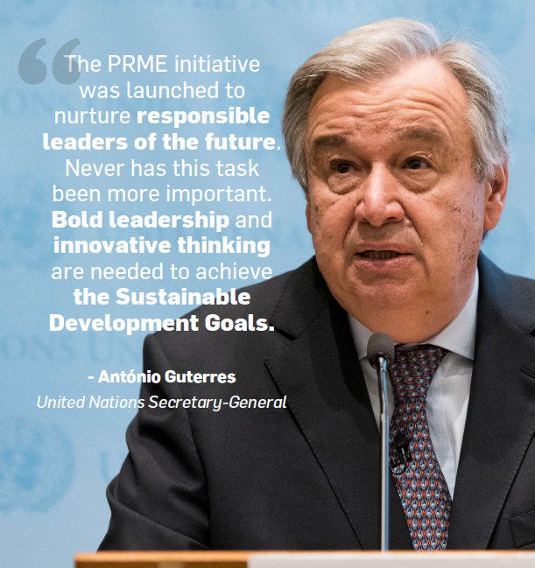

TRANSFORMING MANAGEMENT EDUCATION
Notes:
The Principles for Responsible Management Education were developed in 2007 by an international task force of sixty deans, university presidents and official representatives of leading business schools and academic institutions.
The development of a principle-based global engagement platform for academic institutions follows from a recommendation by academic stakeholders of the UN Global Compact. The idea was officially introduced by the UN Global Compact at the Global Forum "Business as an Agent of World Benefit" at Case Western Reserve University in October 2006.

Slide 10
PRME … a Global Movement
of Responsible Management Education
Today, PRME is the world’s largest
UN-supported initiative to engage management schools and management and leadership development institutions in the advancement of responsible leadership and sustainable development.
6

Slide 11




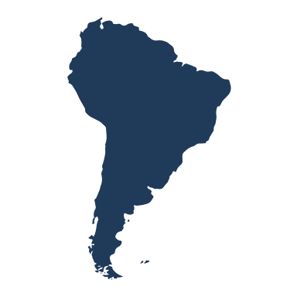


PRME by the numbers...
A network of over 3 million students and over 200 thousand faculty
860+ Signatories
37 Champions
17+ Regional Chapters
9 Working Groups

Slide 12
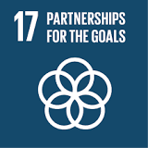
United Nations: The Sustainable Development Goals (SDGs) can only be realized with a strong commitment to global partnership and cooperation. Coordinating policies to help developing countries manage their debt, as well as promoting investment for the least developed, is vital to achieve sustainable growth and development. Goal 17: Partnerships for the goals | Sustainable Development ...
THE HOPE. Partnerships that engage business in international development collaborations are part of a new drift
towards private sector development and market-based approaches to poverty-alleviation and climate change
(Thorpe, 2018; Blowfield & Dolan, 2014).
THE DEFINITION. Sustainability partnerships “is a process through which parties who see different aspects of
a problem can constructively explore their differences and search for solutions that go beyond their own
limited vision of what is possible.” (Gray, 1989)

Slide 13
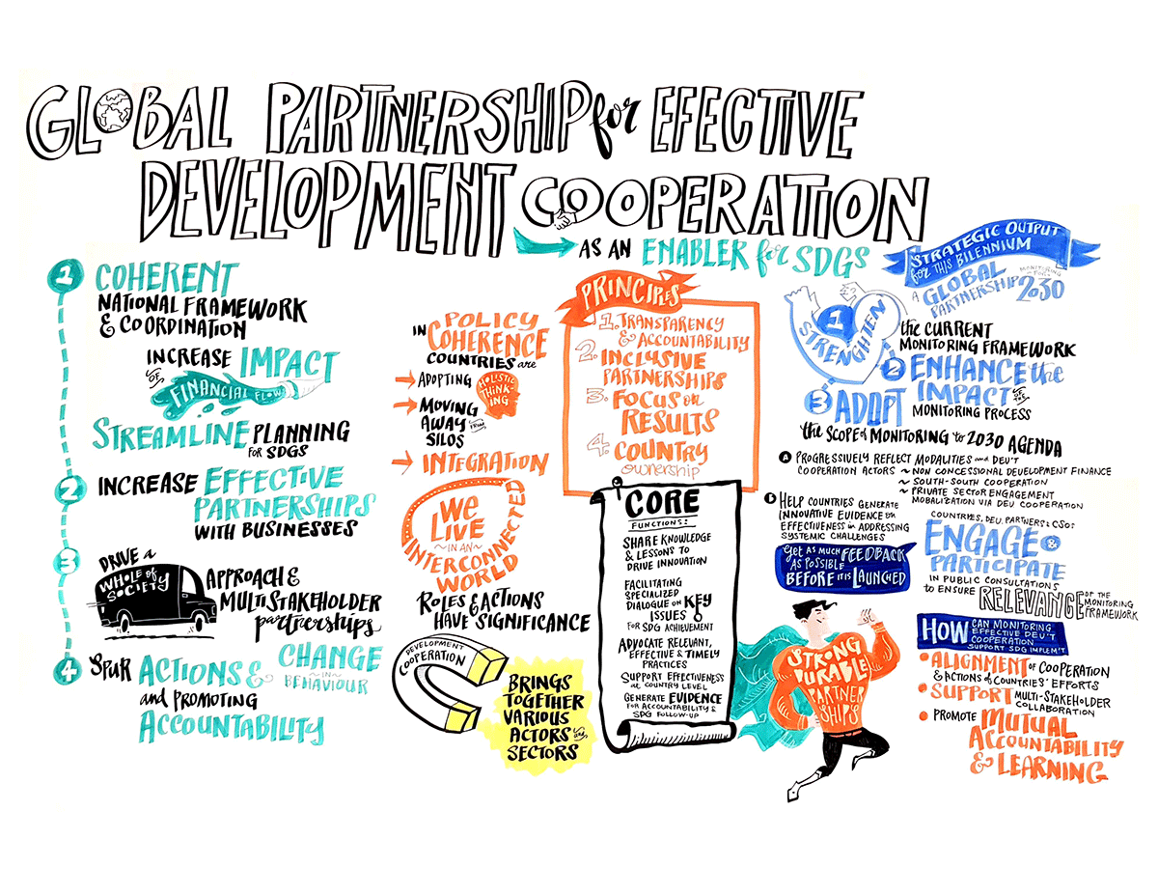




Slide 14
Three categories of Sustainable Partnerships
Nonprofit Sector
Public-NPO Partnerships
NPO-Business Partnerships
Multipartite Partnerships
Public Sector
Profit Sector
Public-Private Partnerships
Philanthropic
Transactional
Integrative
Modest (e.g. reputational)
Increase in strategic importance
Joint benefit creation
Academic Sector
Level of Benefits
Not particularly important
Overlaps in mission
Collective action
Importance to Mission
Not economically critical
Beyond monetary resources
Further increase of resource exchange
Magnitude of Resources
Minimized interaction
More active communication
Intensity in personal interaction
Interaction Frequency
On lower levels
Shared vision at the top
Integration (e.g. Boards)
Managerial Involvement
14
Source: Austin (2000)
14
14

Slide 15
Three categories of Sustainable Partnerships
Nonprofit Sector
Public-NPO Partnerships
NPO-Business Partnerships
Multi-partite Partnerships
Public Sector
Profit Sector
Public-Private Partnerships
Philanthropic
Transactional
Integrative
Academic Sector
Partnership focus
FOCUS ON OUTPUT
FOCUS ON OUTCOMES
FOCUS ON IMPACT
Level of transformation
Activities
For example:
products, services,
agreements produced in partnerships
Positive and negative effects on beneficiaries
For example:
increased salary, schools for poor children, enhanced security, improved health, increased voice
Longterm direct and indirect effects of outcomes on local /global governance
For example: health, education, inequality, child labor, modern slavery, zero emissions, gender equality, empowerment to make own strategic life choices
Examples of activities
15
Source: Austin (2000)

Slide 16
Partners’ wants and contributions to sustainable partnerships
Business perspective
WANTS to go beyond donations, lobbying, adopting simple programmes to integrate sustainability into its own business operations
Seeking more ambitious product/ process innovations for ‘wicked problems’ where no predefined business/tech solutions exist
Wants access to expertise on new markets, new geographies, anticipating new regulatory frameworks and legitimacy
CONTRIBUTING resources, expertise and short-term execution
Government perspective
WANTS to seek contributions when sustainability problems are not addressed
Supporting societal development by corporate expertise, technologies and resources
Seeking national and/or international collaborations on what are profoundly transnational issues, i.e. clean water, air, human rights
CONTRIBUTING supportive gradual regulatory frameworks and institutionalizing sustainable development norms and laws for societal betterment
Academic perspective
WANTS to contribute facts, evidence, novel knowledge to stimulate societal development
Researching in support of societal development by novel insights, evidence, technologies (incl. aggregate data: ‘what works what does not work’)
Educating in support of national and/or international collaborations on what are profouonndly transnational issues, i.e. clean water, air, human rights
CONTRIBUTING facts and a unique value-free space for testing innovative solutions to sustainable development
NGO perspective
WANTS to focus on the beneficiary perspective of partnerships
Challenging market solutions and governmental deficiencies to societal development
CONTRIBUTING longstanding granular on-the-ground local knowledge of needs, concerns and how to mobilize local communities
Beneficiary perspective
WANTS longterm access to good governance, health, education, security, peace and a good environment
CONTRIBUTING: societal development, ddevelopment of local communities and peace
Reference, drawing on: Stadtler and Kourola, in press, Cambridge university Press

Slide 17
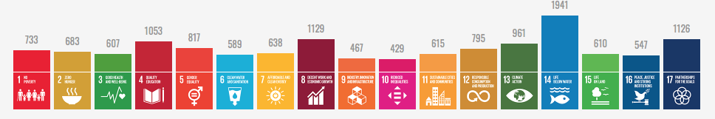
Why Do We Discuss Partnerships as a Leadership Challenge?
Number of Partnerships registered with the UN in support of the SDGs (2020)
But: Studies show that cross-sector partnerships rarely reach expectations. According to the Global Sustainability Partnership Database:
38% of partnerships show no activities at all;
26% of partnerships, outputs did not match expectations
12% of partnerships, some outputs matched expectations
24% of partnerships, all output matched expectations

Slide 18

PRME
– a focus on partnerships in Management Education
SUCCESS (redefinition)
SOCIETY (what’s the goal)
SKILLS (pedagogies)

Slide 19
Thank you for engaging!
mail: Morsing@unglobalcompact.org
twitter: @Mette_Morsing

